Slide 1
DiffNet++: A Neural Influence and Interest Diffusion network for Social Recommendation
Hemanth Kongara

Slide 2
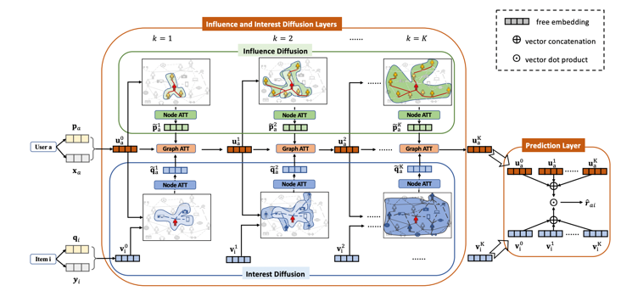
Technical Details
Embedding layer
Fusion layer
Influence and Interest Diffusion
Prediction Layer
Diffnet++ Architecture

Slide 3
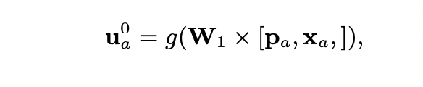
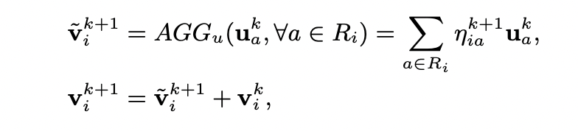
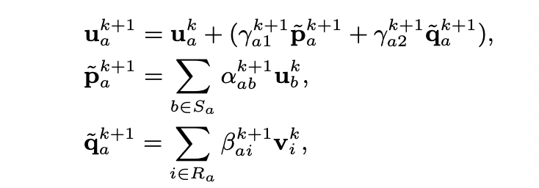
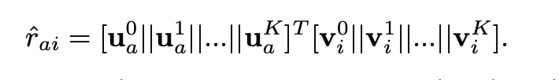
Technical Details
Fusion Layer
Influence and Interest Diffusion layers
For items
For Users
Prediction Layer

Slide 4
Contributions (Novelty)
In this work, the performance of diffnet++ model with different dimensions is compared
I also proposed a modified diffnet++ model with a different prediction layer and compared its performance with the model proposed in the paper
This work also includes comparison of outputs the model with different trails.

Slide 5
Results & Conclusion
Table. 1. Results of different dimensions
Table. 2. Results of Prediction function using only last layer
Dimension | N=5 |  | N=10 |  | N=15
 | HR | NDCG | HR | NDCG | HR | NDCG
8 | 0.0863 | 0.0611 | 0.1344 | 0.0783 | 0.1718 | 0.0896
16 | 0.0685 | 0.0490 | 0.1092 | 0.0635 | 0.1425 | 0.0735
32 | 0.1772 | 0.1278 | 0.2669 | 0.1599 | 0.3342 | 0.1803
64 | 0.2199 | 0.1614 | 0.3302 | 0.2010 | 0.4064 | 0.2239
Dimension | N=5 |  | N=10 |  | N=15
 | HR | NDCG | HR | NDCG | HR | NDCG
8 | 0.0775 | 0.0545 | 0.1220 | 0.0705 | 0.1515 | 0.0794
16 | 0.0777 | 0.0561 | 0.1188 | 0.0708 | 0.1609 | 0.0834
32 | 0.1339 | 0.0961 | 0.2149 | 0.1253 | 0.2759 | 0.1437
64 | 0.2086 | 0.1318 | 0.3181 | 0.1914 | 0.3725 | 0.1876
Table. 3. Results of different trails (D=64)
Trail No. | N=5 |  | N=10 |  | N=15
 | HR | NDCG | HR | NDCG | HR | NDCG
1 | 0.1229 | 0.0908 | 0.1988 | 0.1179 | 0.2551 | 0.1347
2 | 0.2199 | 0.1614 | 0.3302 | 0.2010 | 0.4064 | 0.2239
3 | 0.1984 | 0.1456 | 0.2985 | 0.1816 | 0.3681 | 0.2025
4 | 0.1372 | 0.1008 | 0.2176 | 0.1295 | 0.2737 | 0.1463
HR-hit Ratio NDCG-Normalized Discounted Cumulative Gain

Slide 6
Results & Conclusion
Hit Ratio and NDCG increased with the number of dimensions
The prediction layer with only last layer performance is less compared to the model presented in the paper
The model output is highly dependent on the initialization
References
1. Wu, Le and Li, Junwei and Sun, Peijie and Ge, Yong and Wang, Meng, “DiffNet++: A Neural Influence and Interest Diffusion Network for Social Recommendation” 2020.
.

